Slide 1
Data Wrangling with OpenRefine
Jay Brodeur
Do More with Digital Scholarship Workshop Series
February 1, 2021

Slide 2

McMaster University sits on the traditional Territories of the Mississauga and Haudenosaunee Nations, and within the lands protected by the | “Dish With One Spoon” wampum agreement.
McMaster University sits on the traditional Territories of the Mississauga and Haudenosaunee Nations, and within the lands protected by the “Dish With One Spoon” wampum agreement.

Slide 3
Learning Objectives
By the conclusion of this workshop, you should be able to:
Describe the basic principles of data wrangling and situations where it is useful
Apply the basic functionality of OpenRefine to clean, explore, and analyze messy data
Use OpenRefine to wrangle your own ‘messy’ data
Identify where to find more information and support

Slide 4
Data & Data Wrangling

Slide 5
Every Project Has Data!
Chances are that your project contains at least one (and likely more) data types:
Text, images, tags, geographical coordinates, categorical items, records, metadata, multimedia, etc.
Understanding your data and your intended actions is a critical part of developing a DS/DH project
It guides your data activities
It helps inform you of the ways in which your data can be used -- by you, your collaborators and others in your research community

Slide 6
Ideation
Ideas
Interests
Questions
Hypotheses
Analyses / Applications
Methods
Tools
Visual
Textual
Qualitative
Quantitative
Dissemination
Visualization
Multimedia
Monograph
Article
Web Page

Slide 7
Data
Ideation
Ideas
Interests
Questions
Hypotheses
Analyses / Applications
Methods
Tools
Visual
Textual
Qualitative
Quantitative
Dissemination
Visualization
Multimedia
Monograph
Article
Web Page

Slide 8
Data Preparation
Getting data
Ideation
Ideas
Interests
Questions
Hypotheses
Analyses / Applications
Methods
Tools
Visual
Textual
Qualitative
Quantitative
Dissemination
Visualization
Multimedia
Monograph
Article
Web Page

Slide 9
Data Preparation
Getting data
Assessing it
Cleaning it
Transforming it
Depositing it for use and sharing
Ideation
Ideas
Interests
Questions
Hypotheses
Analyses / Applications
Methods
Tools
Visual
Textual
Qualitative
Quantitative
Dissemination
Visualization
Multimedia
Monograph
Article
Web Page
Data Wrangling

Slide 10
Defining data wrangling
wran·gle v.tr
To manage or herd
To manage or control
To grasp and maneuver (something); wrestle
To win or obtain by argument

Slide 11
Defining data wrangling
wran·gle v.tr
To manage or herd
To manage or control
To grasp and maneuver (something); wrestle
To win or obtain by argument
wran·gle v.intr
To attempt to deal with or understand something; contend or struggle

Slide 12
Defining data wrangling
wran·gle v.tr
To manage or herd
To manage or control
To grasp and maneuver (something); wrestle
To win or obtain by argument
wran·gle v.intr
To attempt to deal with or understand something; contend or struggle
wran·gle n.
An angry, noisy argument or dispute.

Slide 13
Defining data wrangling
In the context of data, DATA WRANGLING:
Is the process of cleaning and conditioning data into a usable format
May be a manual, semi-automated or automated process
Produces data that connects to tools, collaborators and communities

Slide 14
Why wrangle?
Even if you understand and work well with your data, it doesn’t mean that a computer will be able to use it to the same extent.
Computers (like people) are only as flexible/adaptable as far as they have been trained or instructed.
Therefore, it often takes work to structure your information/data in a way that can be used in a computing environment.

Slide 15
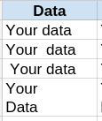
Why wrangle?
Because this happens → ← , and this can be a problem
From School of Data’s Data Cleaning Module: “the Invisible Man is in your spreadsheet, messing with your data”
http://schoolofdata.org/handbook/courses/data-cleaning-invisible-man-in-spreadsheets/

Slide 16
Understanding your needs

Slide 17
What is your ‘data’?
What kind of ‘wrangling’ is required?

Slide 18
Data wrangling: BIG impact, even for small data
Whether your data is small or “BIG”, conditioning it is critical.

Slide 19
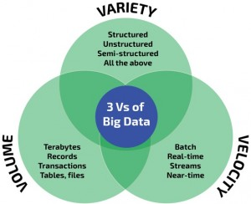
Big data is defined by the 3 “V”s

Slide 20
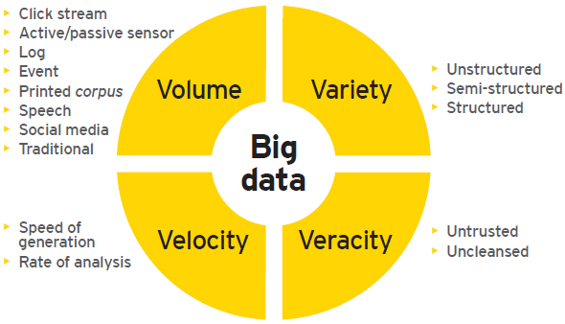
...or the 4 “V”s

Slide 21
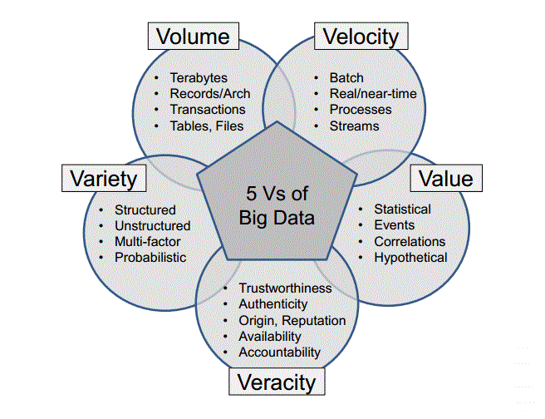
...or 5?

Slide 22
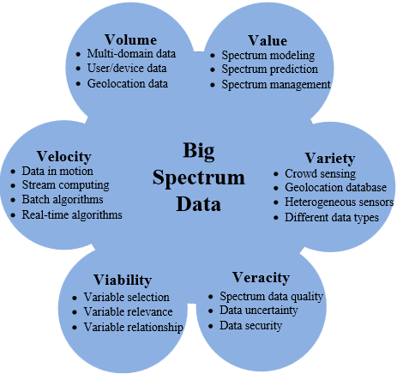
6? Really?

Slide 23
Factors Influencing Your Wrangling Needs
Your data might...
be voluminous and dynamic
come from very diverse sources in a variety of formats and structures
vary considerably in quality and consistency (i.e. may require heavy scrutiny)
Or it might not be...
All of these factors influence your data wrangling needs and potential solutions!

Slide 24
What else matters?
Other factors that will affect the nature of your wrangling activities:
What tools are you using?
Are automated approaches available?
What formats are required for later analyses?
How tolerant are you to errors?

Slide 25
Getting & Assessing Your Data
Downloading Files
API access
Web-scraping

Slide 26
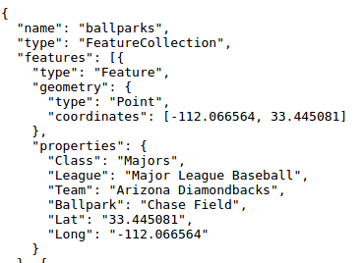
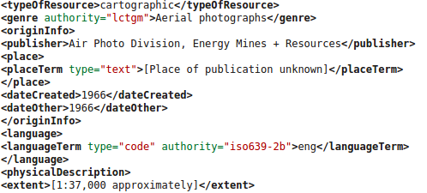
Bulk Downloads
Common data formats
ASCII text
Delimited ASCII (.csv, .tsv)
PDF
JSON (https://goo.gl/632RGb)
Markup languages (TEI, HTML, XML)
Multimedia (.wav, .ogg, .mp4, .mkv)
Other, program-specific and ad-hoc file formats (fixed width, SAS, xls)

Slide 27

API Access
API = Application program interface
set of protocols/tools for building software applications
governs how software should interact with each other and user interfaces
Reddit API: https://www.reddit.com/dev/api New York Times API: http://developer.nytimes.com/docs

Slide 28
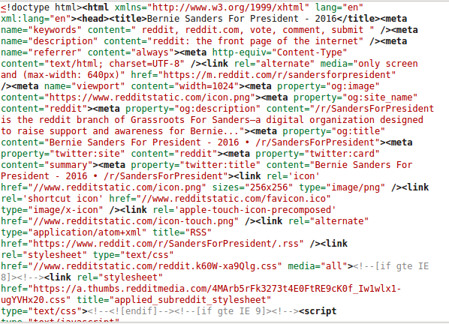
Web Scraping
Scraping vs. Parsing:
Parsing: data being extracted is intended as input to another program
Scraping: data being extracted is intended for display to an end user
e.g. > wget https://www.reddit.com/r/sandersforpresident
Scrapes web page html to file →

Slide 29
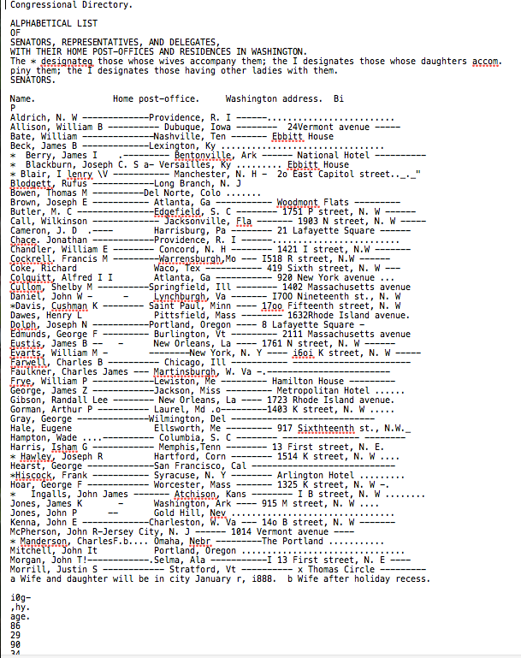
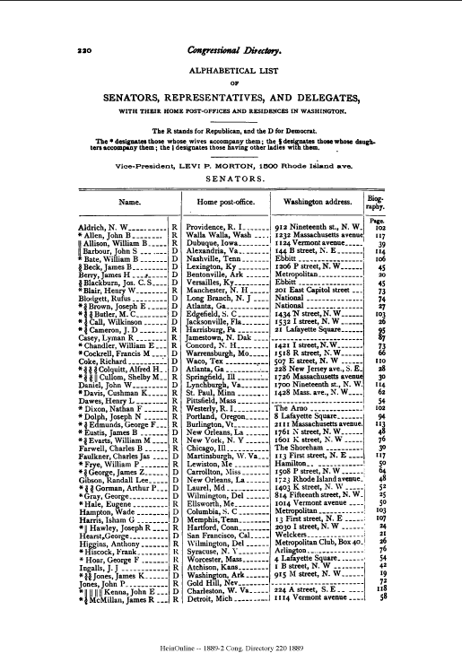
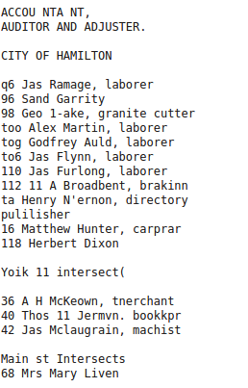
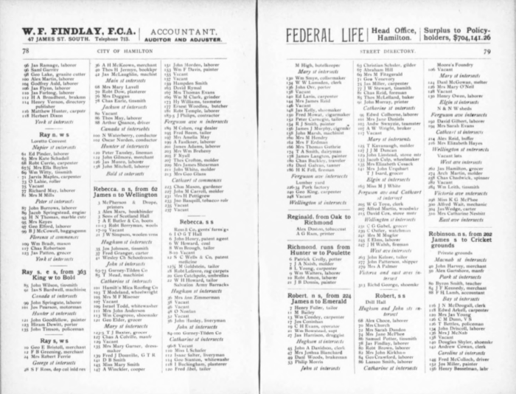
Scanned / OCRed Data

Slide 30
Cleaning & Transforming Your Data

Slide 31
Data Cleaning: Goal & Activities
Goal: Create data sets that are consistent and interoperable with other data of interest
Data cleaning (scrubbing) may include:
Detecting and remediating corrupt/inaccurate records
Removing typographical errors
Validating against a known list of possibilities (e.g. verify a string as a postal code)
Eliminating duplicate entries
Harmonizing and standardizing (e.g. represent ‘St’, ‘St.’, ‘Street’ as ‘street’)
Cleaning may be carried out
Manually (interactive)
Semi-automatically (guided)
Automatically (scripted)

Slide 32
So, when to let the computer take over?
Whenever it works and will save you time!
Time / Effort to Complete
Potential for Calamity
a file; page of text, etc.
many, diverse datasets; corpora
# of files/items to wrangle

Slide 33
Spreadsheets: The frenemy of research
Doing it manually
Time / Effort to Complete
Potential for Calamity
a file; page of text, etc.
many, diverse datasets; corpora
# of files/items to wrangle

Slide 34
Spreadsheets: The frenemy of research
Doing it manually
Time / Effort to Complete
Potential for Calamity
Doing it automatically
a file; page of text, etc.
many, diverse datasets; corpora
Also see this: https://xkcd.com/1205/ (thanks Chris!)
# of files/items to wrangle

Slide 35
Final Thoughts and Strategies

Slide 36
Experimentation and Documentation
Often, experimentation and iteration are important in establishing the best way to get your data into ‘shape’.
Starting with a sample of data is a good approach.
It’s important to document your outcomes and your process

Slide 37
How to save time in the long run…
Look for tools that exist to help you wrangle your data
automated or semi-automated (guided) cleaning
data transformation
converting between data formats
Seek out tutorials / instruction for the tools you’re using
Control your data at the point of collection - refine your process to reduce ‘garbage in’
e.g. when crowdsourcing data -- use controlled fields and vocabularies; insert data validation processes

Slide 38
Data Wrangling with OpenRefine

Slide 39
What is OpenRefine?
Formerly known as “Google Refine”
Free & open-source
Tool for cleaning messy, large-ish datasets (100,000 rows)
Desktop application – runs locally through your (modern) browser, e.g., Firefox or Chrome

Slide 40
Why OpenRefine?
Powerful, but ‘easy’ to use – low learning curve
Can import data from variety of sources, including directly from the web
Retains log of all data cleaning actions (i.e. you can revert your changes)
Does not modify original data files
Browser-based, so works on most computers (can even run it off of a flash drive)
Can track, export, and re-apply actions across datasets
Apply powerful clustering algorithms to help clean your data
https://openrefine.org

Slide 41
Time to get started
Go to scds.github.io/data-wrangling/ for a introduction and preparation
Then, complete the Data Carpentries self-serve OpenRefine Workshop https://datacarpentry.org/openrefine-socialsci/
If you have questions, register for the OpenRefine drop-in session on February 11, 2021: u.mcmaster.ca/dmds-data-wrangling-drop-in

